Slide 1
Unit 6: For Live Session Assignment
Comparing Linear Combinations of Mean and
How to adjust for running many tests at once!

Slide 2
Part 1

Slide 3
Quick Quiz Questions

Slide 4
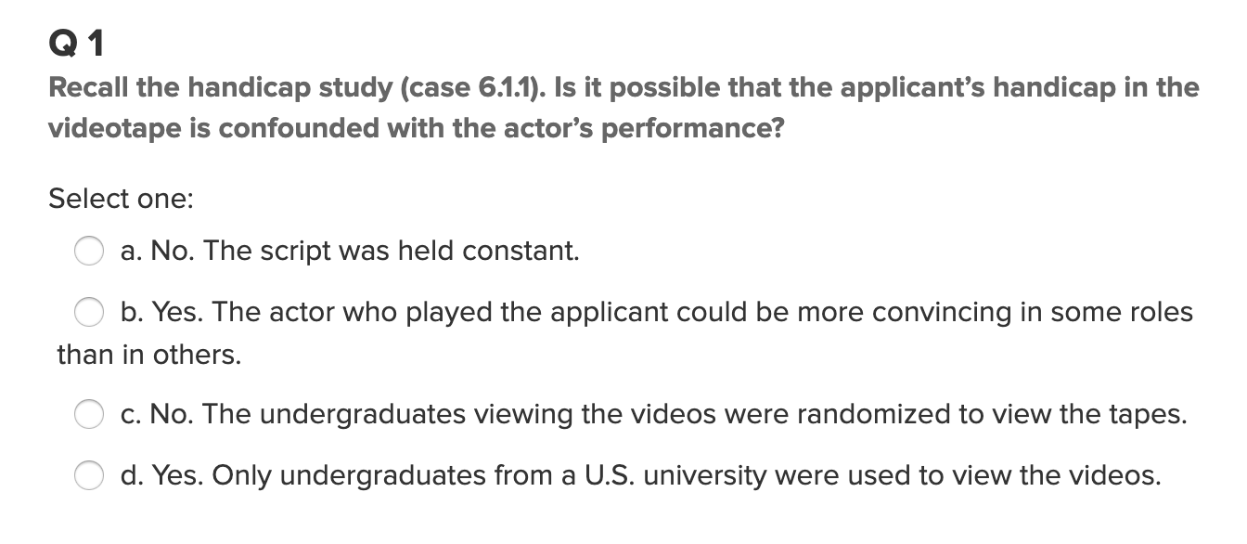
Question 1 (<15 min)

Slide 5
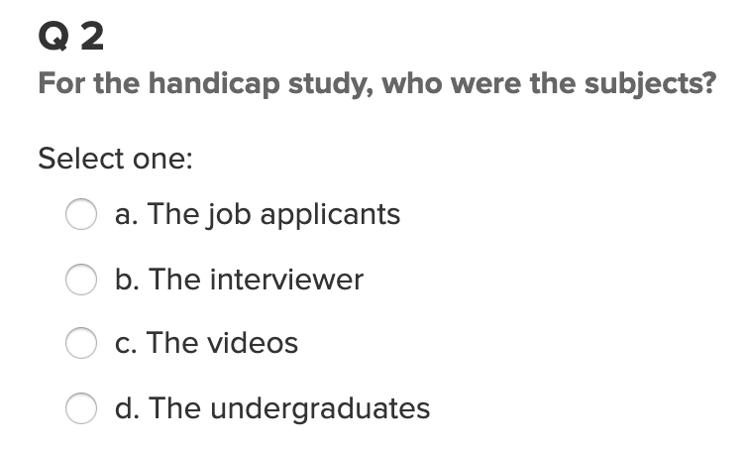
Question 2 (< 15 min)

Slide 6
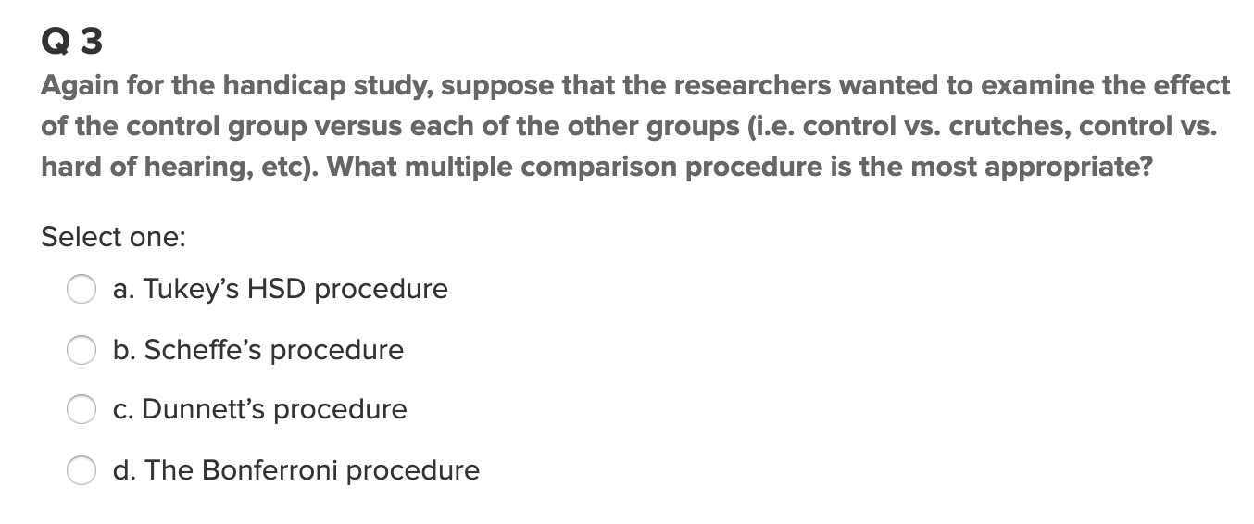
Question 3 (< 15 min)

Slide 7
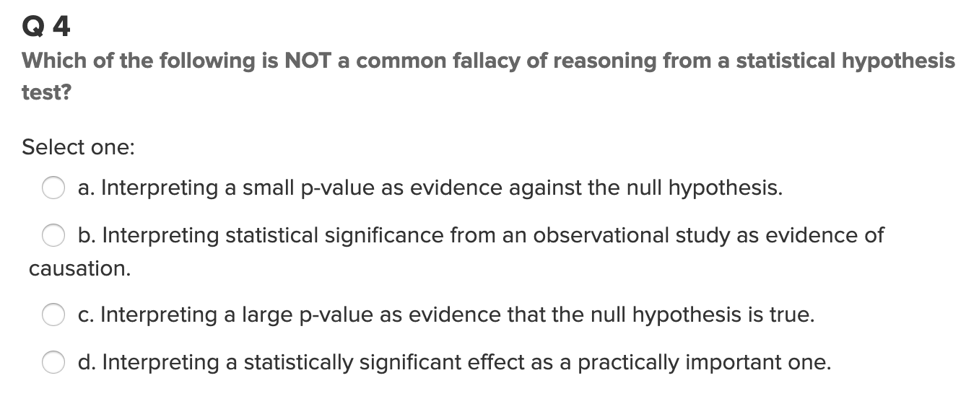
Question 4 (< 15 min)

Slide 8
End Part 1

Slide 9
Part 2

Slide 10
Attempt Two Questions from the HW this Week!
Please put your responses for each question on slides so you can easily and effectively present / share them to your peers in live session!
Be sure and also eventually put them in document form to submit them as homework on or before Sunday.
Remember, the assignment is to attempt each problem. The correct answer is not required to get full credit, but a full attempt is. If you exhaust the minimum amount of time required to attempt the problem without a solution, there must have been some issues that popped up. In this case, fully describe what these issues were, how they were addressed, what was learned in addressing them. Basically, whether you arrived at a complete answer or not, use the slides to explain the path that you explored in that time. I can’t tell how much this will help everyone in live session.

Slide 11
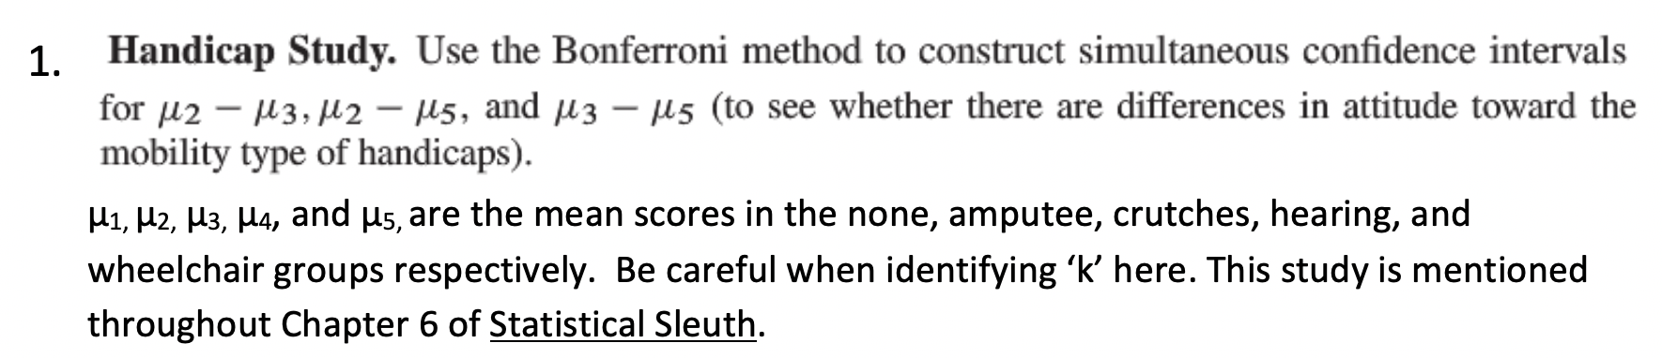
Question 1 (< 2 hours)

Slide 12
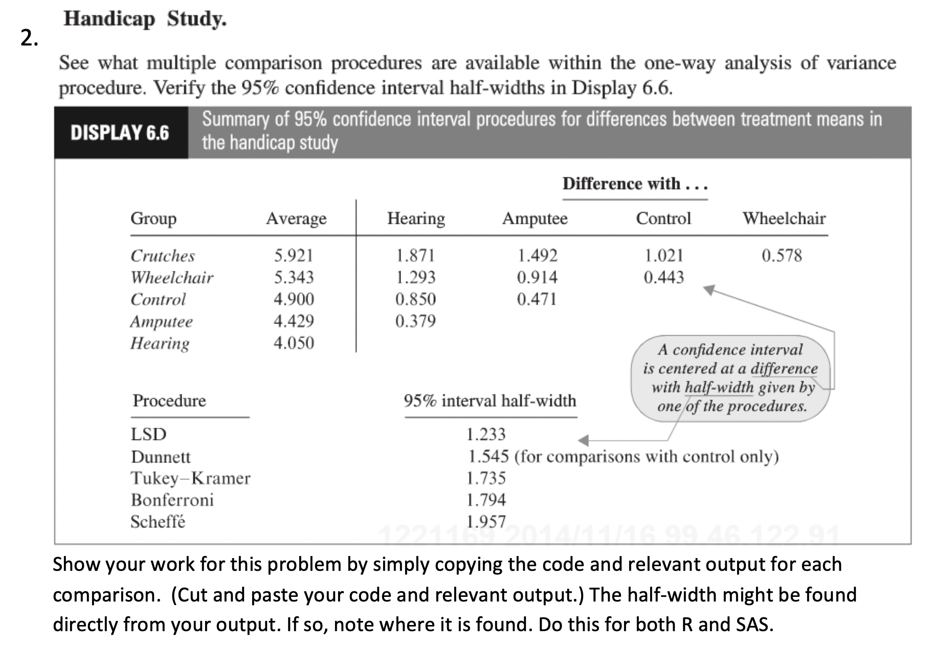
Question 2 (< 2 hours)

Slide 13
End Part 2

Slide 14
Part 3

Slide 15
Takeaways and Questions (1 hour)
Please remember to record you takeways and any questions you may have!

Slide 16
End Part 3

Slide 17
End Unit 6 For Live Session Assignment

